Slide 1
Dots team

Slide 2

Size of stored data by NASA Earth Observatory satellites
19
Zettabytes
200
Terabytes
1980s 1990s 2000s 2010s 2020s 2030s

Slide 3
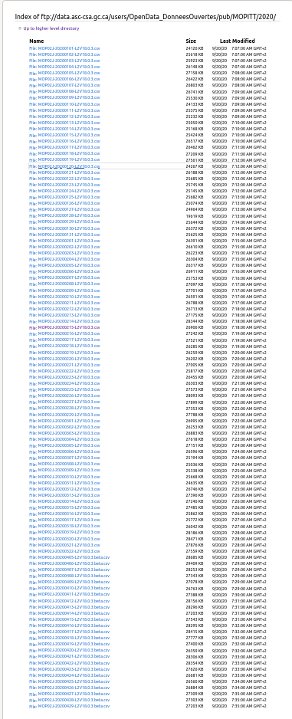
Unorganized and complex data
Insignificant Indexing
Results aren’t fulfilling

Slide 4
Our Solution

Slide 5
Indexing
Inverted indexing
Document1
Document1
Keyword1
Document4
Document2
Document6
Document3
Document2
Document4
Keyword2
Document4
Document8

Slide 6
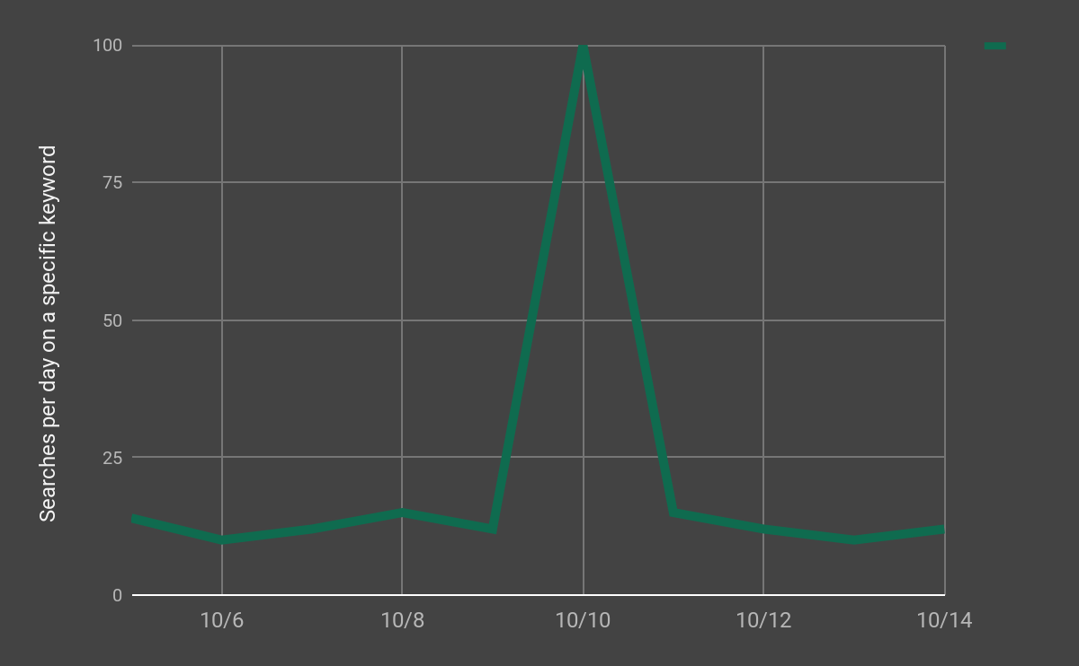
Our service takes advantage of data trend spikes

Slide 7
12.7 Seconds
7.6 Seconds

Slide 8
Conclusion

Slide 9
Q&A

Slide 10
Ahmed Eltokhy
Team Leader
App developer
eltokhy@aucegypt.edu
Ahmed Anwar
Back-end Developer
ahmed.rk30@gmail.com
Mohamed Magdi
Data Analyst
Communications Specialist
moh.magdy.ibrahim@gmail.com
Ibrahim Gohar
Platform Developer
abdelmaksou@aucegypt.edu

Slide 11
Thanks!

